Slide 1
NATURAL LANGUAGE PROCESSING
HOMEWORK – 1
By Ravinthiran Partheepan

Slide 2
Query
Try to construct patters detecting dates in texts (texts can be in any language you want!)

Slide 3
Technical Aspects
Programming Language Used :- Python
Package Used :- Python <- “Date Finder”

Slide 4
Solution for the Query
By Using the Date Finder Library we can Extract the dates Present in the Text.
For Eg: I am having Machine Learning Lecture on 30/September/2019 and Examination on 23/10/2019.
Here’s the Possible dates in the text are “ 30/September/2019” and “23/10/2019”.
The Above mentioned Dates are Given in both String and Numbers.
As with the help of Date Finder Module We Can extract the String entity to a Number Entity also.

Slide 5
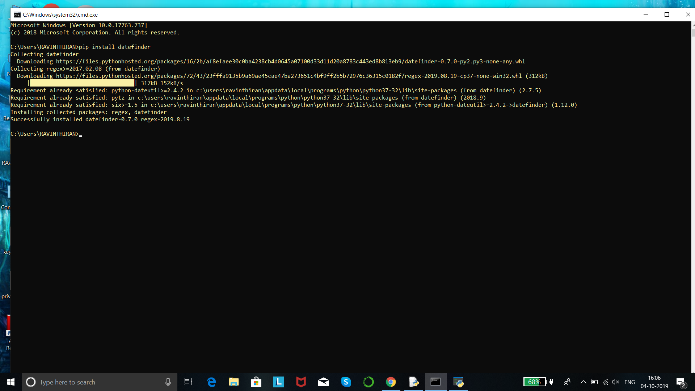
Package Installation
Command :- Pip install datefinder

Slide 6
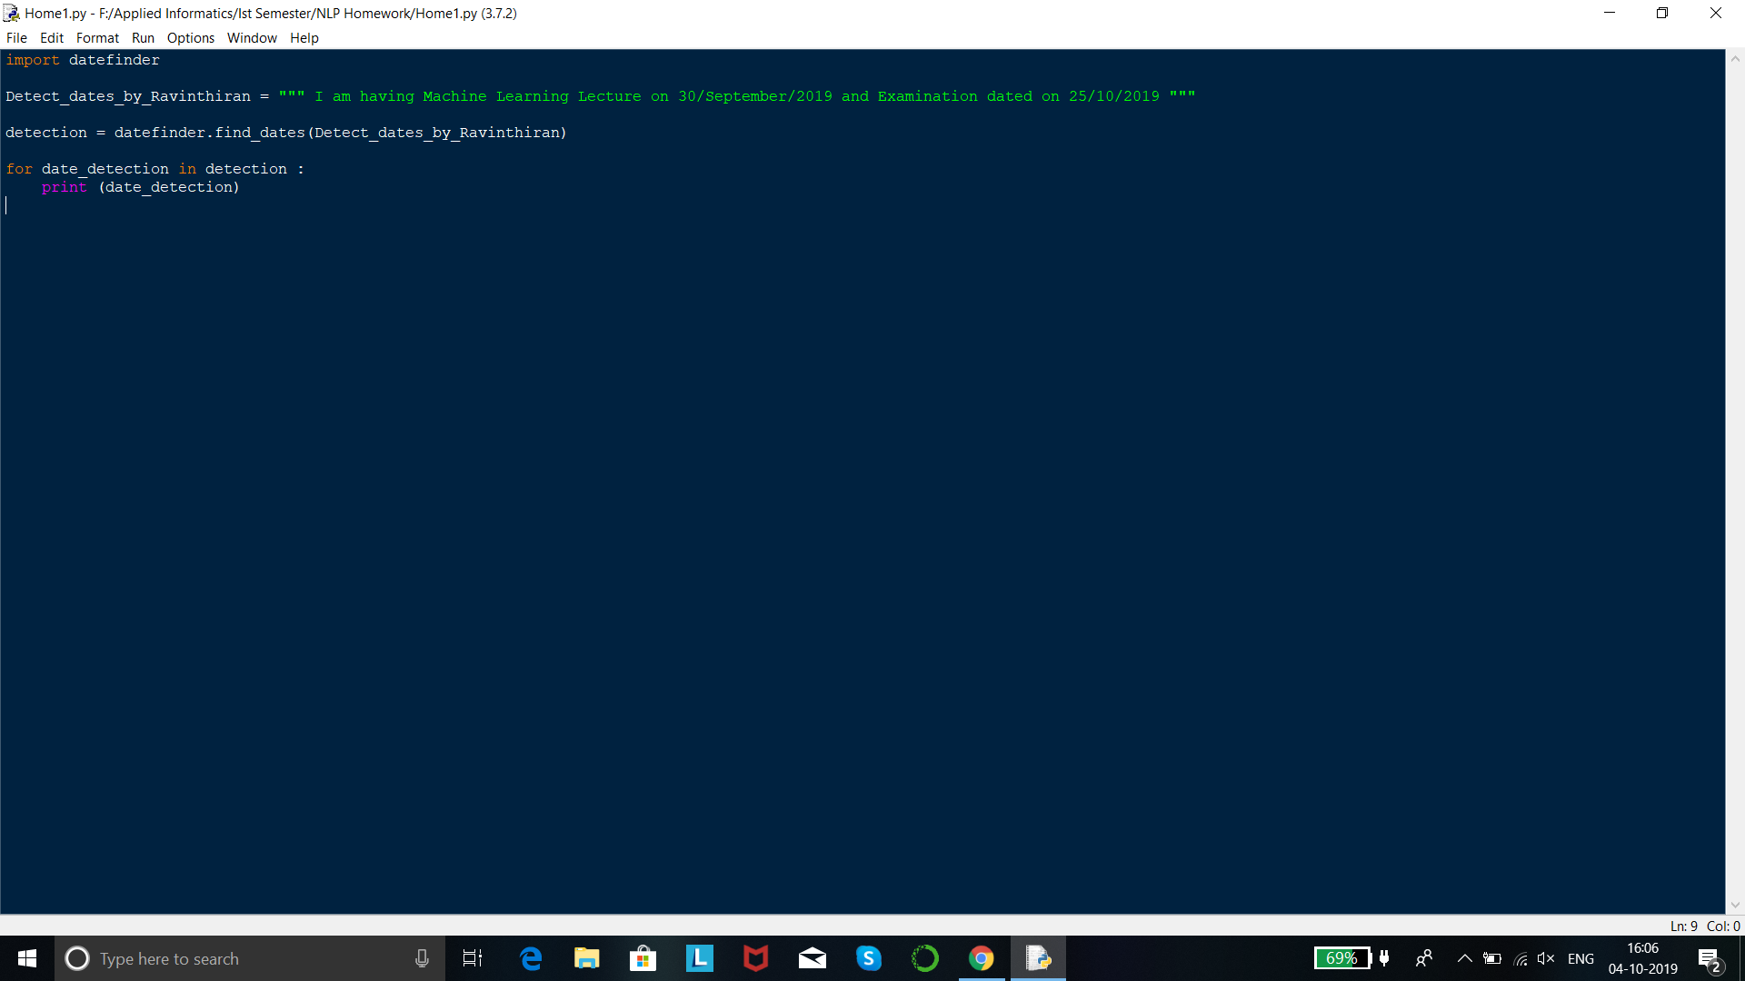
Program Code

Slide 7
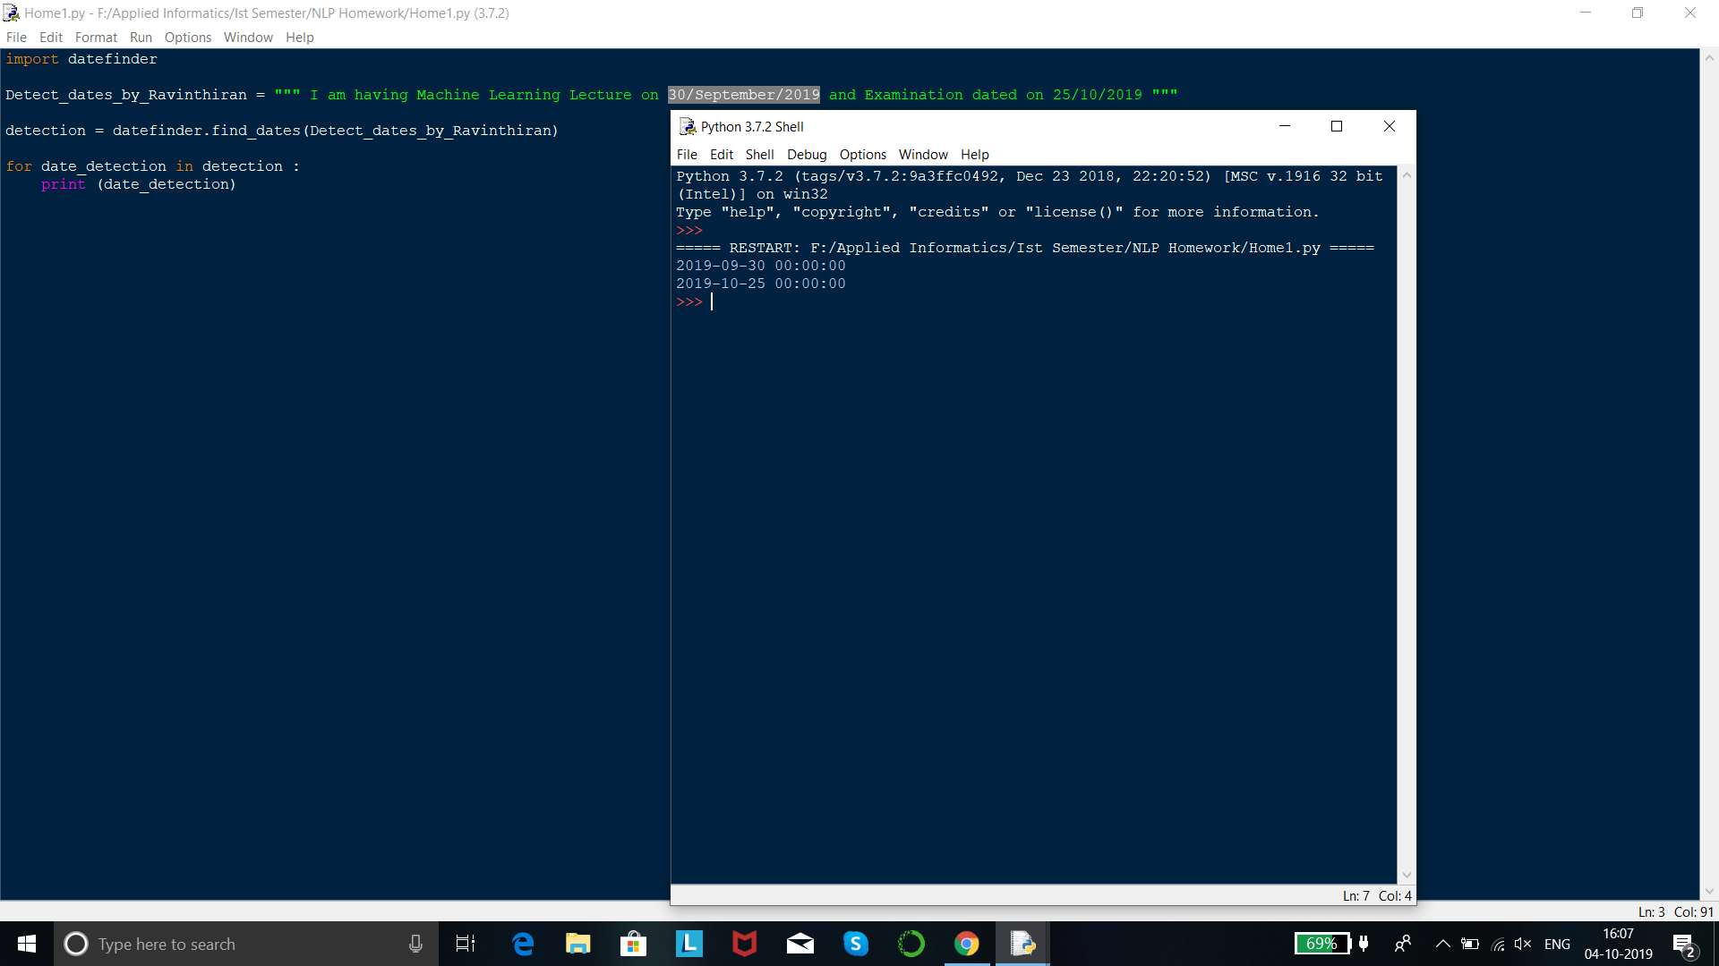
Output

Slide 8
Thank You!

